Slide 1
MS10
Liver as a Model System for Mechanics, Flow, and Multiscale Mathematical Biology
James A. Glazier
Jessica L. Sparks
Paul Macklin
Hermann B. Frieboes
Shannon M. Mumenthaler
Indiana University
Miami University (Ohio)
Indiana University
University of Louisville
University of Southern California
July 17, 2017

Slide 2
Schedule
3:00-3:20 | Macklin | Primer: Liver microanatomy and biology for modelers
3:20-3:40 | Glazier | Sensitivity analysis of toxicity of acetaminophen in a multiscale liver sinusoid simulation
3:40-4:00 | Sparks | Biomechanical modeling of tissue perfusion in decellularized and native liver
4:00-4:20 | Macklin | Agent-based simulation of colon cancer metastases in large liver tissues
4:20-4:40 | Frieboes | Modeling and calibration of cancer drug response
4:40-5:00 | Mumenthaler | High-throughput image-based experiments to drive cancer model development
5:00-5:30 | All | Discussion

Slide 3
MS10
Primer: Liver microanatomy and biology for modelers
James A. Glazier
Jessica L. Sparks
Paul Macklin
Hermann B. Frieboes
Shannon M. Mumenthaler
Indiana University
Miami University (Ohio)
Indiana University
University of Louisville
University of Southern California
July 17, 2017

Slide 4
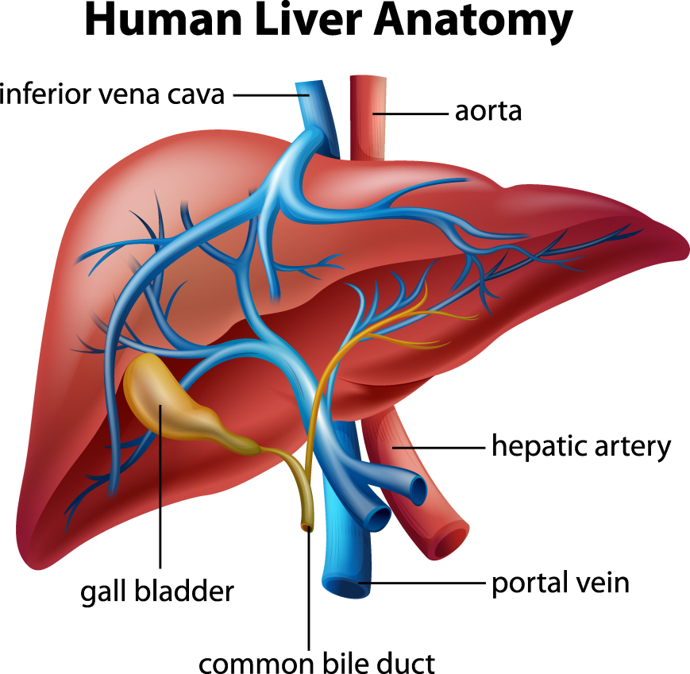
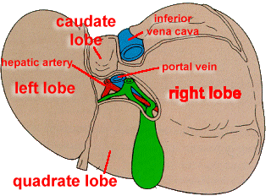
Liver Anatomy
The liver is the largest gland in the body and weighs approximately 3lbs
It receives oxygen- and nutrient-rich blood from hepatic artery and portal vein, respectively
It is comprised of 4 lobes of unequal sizes: right, left, caudate, quadrate
Liver functions: detoxification, production of bile needed for digestion, metabolism (e.g. lipid, drugs), hormone production

Slide 5
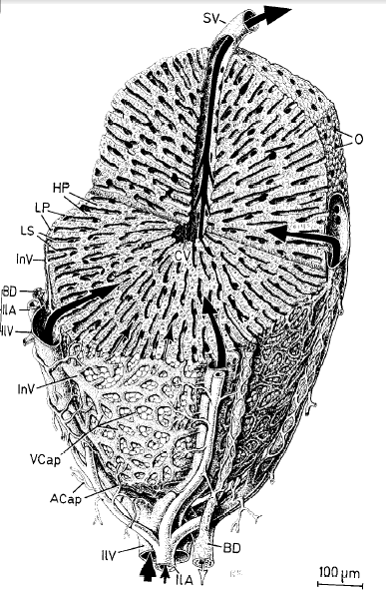
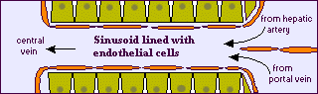


Liver Structure and Function
Primary metabolizing organ of the body and first line of defense against toxins
Live composed of millions of lobules
Blood enters at Portal Triads and Leaves at Central Vein
Lobules composed or repeating triangular modules in which sinusoids take blood from Portal Triad to Central Vein
Sinusoids are capillary-like structures composed of endothelial cells surrounded by hepatocytes
Liver Lobule¹
Liver Sinusoid²
Human Microscopic Anatomy: An Atlas for Students of Medicine and Biology, R. V. Krstic, Springer-Verlag, 1991 (ISBN 978-3-540-53666-6).
http://biology.about.com/library/organs/bldigestliver.htm
Sluka

Slide 6
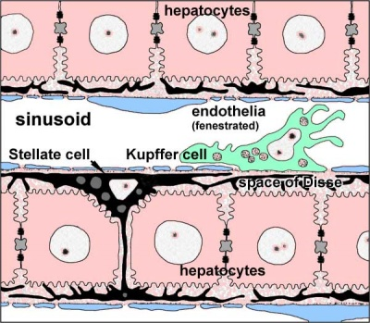
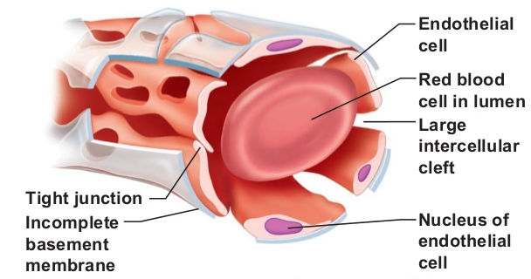
Liver Structure and Function
Primary metabolizing organ of the body and first line of defense against toxins
Live composed of millions of lobules
Blood enters at Portal Triads and Leaves at Central Vein
Lobules composed or repeating triangular modules in which sinusoids take blood from Portal Triad to Central Vein
Sinusoids are capillary-like structures composed of endothelial cells surrounded by hepatocytes
Liver Lobule¹
Transport from plasma to and from Hepatocytes
Transport from Hepatocytes to bile canaliculi
https://embryology.med.unsw.edu.au/embryology/index.php/Gastrointestinal_Tract_-_Liver_Histology
Liver Sinusoid²
Human Microscopic Anatomy: An Atlas for Students of Medicine and Biology, R. V. Krstic, Springer-Verlag, 1991 (ISBN 978-3-540-53666-6).
http://biology.about.com/library/organs/bldigestliver.htm
https://www.slideshare.net/katemilani7/veins-arteries-online
Sluka

Slide 7
Liver Structure and Function
Primary metabolizing organ of the body and first line of defense against toxins
Live composed of millions of lobules
Blood enters at Portal Triads and Leaves at Central Vein
Lobules composed or repeating triangular modules in which sinusoids take blood from Portal Triad to Central Vein
Sinusoids are capillary-like structures composed of endothelial cells surrounded by hepatocytes
Liver Lobule¹
Liver Sinusoid²
Human Microscopic Anatomy: An Atlas for Students of Medicine and Biology, R. V. Krstic, Springer-Verlag, 1991 (ISBN 978-3-540-53666-6).
http://biology.about.com/library/organs/bldigestliver.htm
Sluka

Slide 8
Liver Structure and Function
Primary metabolizing organ of the body and first line of defense against toxins
Live composed of millions of lobules
Blood enters at Portal Triads and Leaves at Central Vein
Lobules composed or repeating triangular modules in which sinusoids take blood from Portal Triad to Central Vein
Sinusoids are capillary-like structures composed of endothelial cells surrounded by hepatocytes
Liver Lobule¹
Liver Sinusoid²
Human Microscopic Anatomy: An Atlas for Students of Medicine and Biology, R. V. Krstic, Springer-Verlag, 1991 (ISBN 978-3-540-53666-6).
http://biology.about.com/library/organs/bldigestliver.htm
Sluka

Slide 9
Liver Structure and Function
Primary metabolizing organ of the body and first line of defense against toxins
Live composed of millions of lobules
Blood enters at Portal Triad and Leaves at Central Vein
Lobules composed or repeating triangular modules in which sinusoids take blood from Portal Triad to Central Vein
Sinusoids are capillary-like structures composed of endothelial cells surrounded by hepatocytes
Liver Lobule¹
Liver Sinusoid²
Human Microscopic Anatomy: An Atlas for Students of Medicine and Biology, R. V. Krstic, Springer-Verlag, 1991 (ISBN 978-3-540-53666-6).
http://biology.about.com/library/organs/bldigestliver.htm
Sluka

Slide 10
Liver Structure and Function
Primary metabolizing organ of the body and first line of defense against toxins
Live composed of millions of lobules
Blood enters at Portal Triad and Leaves at Central Vein
Lobules composed or repeating triangular modules in which sinusoids take blood from Portal Triad to Central Vein
Sinusoids are capillary-like structures composed of endothelial cells surrounded by hepatocytes
Liver Lobule¹
Liver Sinusoid²
Human Microscopic Anatomy: An Atlas for Students of Medicine and Biology, R. V. Krstic, Springer-Verlag, 1991 (ISBN 978-3-540-53666-6).
http://biology.about.com/library/organs/bldigestliver.htm
Sluka

Slide 11
Liver Zonation and Function
Core of lobule around Central Vein (peri-central) has different metabolic function from periphery near Portal Triads (peri-portal)
Liver Lobule¹
Liver Sinusoid²
Human Microscopic Anatomy: An Atlas for Students of Medicine and Biology, R. V. Krstic, Springer-Verlag, 1991 (ISBN 978-3-540-53666-6).
http://biology.about.com/library/organs/bldigestliver.htm
Sluka

Slide 12
Liver Zonation and Function
Core of lobule around Central Vein (peri-central) has different metabolic function from periphery near Portal Triads (peri-portal)
Liver Lobule¹
Liver Sinusoid²
Human Microscopic Anatomy: An Atlas for Students of Medicine and Biology, R. V. Krstic, Springer-Verlag, 1991 (ISBN 978-3-540-53666-6).
http://biology.about.com/library/organs/bldigestliver.htm
Sluka

Slide 13
Liver Zonation and Function
Core of lobule around Central Vein (peri-central) has different metabolic function from periphery near Portal Triads (peri-portal)
Pericentral region largely uses Phase I detoxification (modification by Cytochrome P450s)
Periportal region largely uses Phase II detoxification (conjugation by transferases)
Liver Lobule¹
Liver Sinusoid²
Human Microscopic Anatomy: An Atlas for Students of Medicine and Biology, R. V. Krstic, Springer-Verlag, 1991 (ISBN 978-3-540-53666-6).
http://biology.about.com/library/organs/bldigestliver.htm
Sluka

Slide 14
Liver Structure and Function
Bile flows from the hepatocytes to the very small diameter bile canaliculi (too small to see within the liver at this scale)
Then aggregates to flow out via the bile duct
The bile vessels wrap around the blood vessels, facilitating molecular interchange between bile and blood
Liver Lobule¹
Liver Sinusoid²
Human Microscopic Anatomy: An Atlas for Students of Medicine and Biology, R. V. Krstic, Springer-Verlag, 1991 (ISBN 978-3-540-53666-6).
http://biology.about.com/library/organs/bldigestliver.htm
Sluka

Slide 15
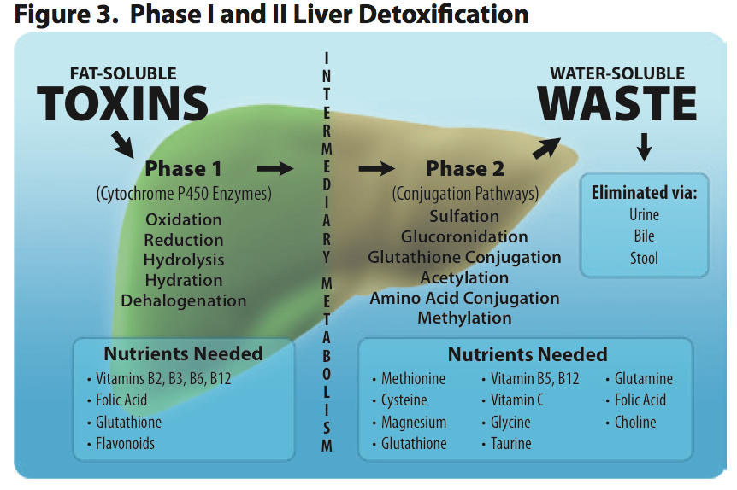
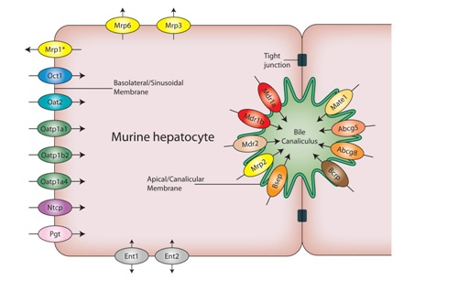
Metabolism and Transport in the Liver
Cytochrome Function
Metabolic role of hepatocytes
Transport in hepatocytes
Family | Function | Members | Names
CYP1 | drug and steroid (especially estrogen) metabolism, benzo[a]pyrene toxification (forming (+)-benzo[a]pyrene-7,8-dihydrodiol-9,10-epoxide) | 3 subfamilies, 3 genes, 1 pseudogene | CYP1A1, CYP1A2, CYP1B1
CYP2 | drug and steroid metabolism | 13 subfamilies, 16 genes, 16 pseudogenes | CYP2A6, CYP2A7, CYP2A13, CYP2B6, CYP2C8, CYP2C9, CYP2C18, CYP2C19, CYP2D6, CYP2E1, CYP2F1, CYP2J2, CYP2R1, CYP2S1, CYP2U1, CYP2W1
CYP3 | drug and steroid (including testosterone) metabolism | 1 subfamily, 4 genes, 2 pseudogenes | CYP3A4, CYP3A5, CYP3A7, CYP3A43
CYP4 | arachidonic acid or fatty acid metabolism | 6 subfamilies, 12 genes, 10 pseudogenes | CYP4A11, CYP4A22, CYP4B1, CYP4F2, CYP4F3, CYP4F8, CYP4F11, CYP4F12, CYP4F22, CYP4V2, CYP4X1, CYP4Z1
CYP5 | thromboxane A₂ synthase | 1 subfamily, 1 gene | CYP5A1
CYP7 | bile acid biosynthesis 7-alpha hydroxylase of steroid nucleus | 2 subfamilies, 2 genes | CYP7A1, CYP7B1
CYP8 | varied | 2 subfamilies, 2 genes | CYP8A1 (prostacyclin synthase), CYP8B1 (bile acid biosynthesis)
CYP11 | steroid biosynthesis | 2 subfamilies, 3 genes | CYP11A1, CYP11B1, CYP11B2
CYP17 | steroid biosynthesis, 17-alpha hydroxylase | 1 subfamily, 1 gene | CYP17A1
CYP19 | steroid biosynthesis: aromatase synthesizes estrogen | 1 subfamily, 1 gene | CYP19A1
CYP20 | unknown function | 1 subfamily, 1 gene | CYP20A1
CYP21 | steroid biosynthesis | 2 subfamilies, 1 gene, 1 pseudogene | CYP21A2
CYP24 | vitamin D degradation | 1 subfamily, 1 gene | CYP24A1
CYP26 | retinoic acid hydroxylase | 3 subfamilies, 3 genes | CYP26A1, CYP26B1, CYP26C1
CYP27 | varied | 3 subfamilies, 3 genes | CYP27A1 (bile acid biosynthesis), CYP27B1 (vitamin D₃ 1-alpha hydroxylase, activates vitamin D₃), CYP27C1 (unknown function)
CYP39 | 7-alpha hydroxylation of 24-hydroxycholesterol | 1 subfamily, 1 gene | CYP39A1
CYP46 | cholesterol 24-hydroxylase | 1 subfamily, 1 gene | CYP46A1
CYP51 | cholesterol biosynthesis | 1 subfamily, 1 gene, 3 pseudogenes | CYP51A1 (lanosterol 14-alpha demethylase)
Metabolism of APAP
http://odomhealthandwellness.com/development/wp-content/uploads/2013/03/Screen-Shot-2013-03-04-at-11.52.12-AM.png
https://www.solvobiotech.com/barriers/hepatic-barrier
https://en.wikipedia.org/wiki/Cytochrome_P450

Slide 16
Flow, mechanics, and function are coupled.

Slide 17
Mechanics Matters in Liver
Fluid Shear Stress
Many liver cells are mechanosensitive:
Hepatocytes, cholangiocytes, stellate cells, endothelial cells, portal fibroblasts, hepatic stem and progenitor cells
Examples:
Lozoya et al. (2011): Hepatic stem cells demonstrate stiffness-dependent expression of E-cad
Schmelzer et al. (2010): Increased hepatic differentiation of human fetal liver cells (hFLCs) when cultured under perfusion
Hydrostatic Pressure
Matrix Stiffness
Notes:
Many liver cell types can sense and respond to mechanical cues (shear stress, hydrostatic pressure, ECM stiffness).
Specific studies noted here (Lozoya, Schmelzer) are examples of the impact of mechanical cues on liver stem and progenitor cells, important cells for liver bioengineering strategies.
Citations:
Hsu et al. (2010) Ann Surg 252, 351-357
Janmey et al. (2011) J Cell Sci 124, doi:10.1242/jcs.071001
Gaca et al. (2005) Wound Repair Regen 13(1), A24
Li et al. (2007) Hepatology 46(4), 1246-1256
Miki et al. (2011) Tissue Eng Part C 16, 115-121.

Slide 18
Importance of Biomechanical Conditions in Perfused Liver Organoids
6 ml/min
9 ml/min
Organization of hepatocytes and endothelial cells occurs after 7 days in perfusion bioreactor
1 day
Alb/e-NOS/DAPI
7 days
Moran E. (2015) PhD Dissertation, WFU.
Notes:
Hepatocyte (Hepg2) cells and endothelial cells (es1) cells were seeded in a 50/50 ratio in a decellularized scaffold like the one shown on the previous slide.
After seeding, scaffolds were perfused at 4 different flow rates for 7 days in the perfusion bioreactor.
Cells were stained for alb (hepg2, green) and e-nos (es1, red).
After 1 day, there is little evidence of organization, but after 7 days of perfusion a significant percentage of the vascular structures are lined by endothelial cells only.
Flow may drive self organization of ECs and heps within perfused bioreactors.
This effect may be mediated by nitric oxide (results not shown here).

Slide 19
Disease and health in the liver involve many or most of these elements.

Slide 20
Xenobiotic Liver Injury (DILI)
Liver is the first organ exposed to molecules absorbed by the gut (Xenobiotics) and the main site for molecular breakdown and detoxification
Often the first (main) organ damaged by xenobiotic exposure
Many types of damage depending on acute or chronic exposure—necrosis, steastosis, cirrhosis, cancer,…
Main reason for failure of drug candidates which have shown clinical efficacy
Common, serious and often unpredictable side effect for many environmental chemicals and drugs
Can limit acceptable doses of antibiotics, chemotherapeutics,…
Susceptibility is highly variable within populations
Susceptibility can be variable in a single individual (e.g. depends on alcohol consumption, grapefruit and broccoli consumption, multi-drug interactions, bacterial and viral infections, age, obesity, sleeplessness, time since last meal, …)
Sluka

Slide 21
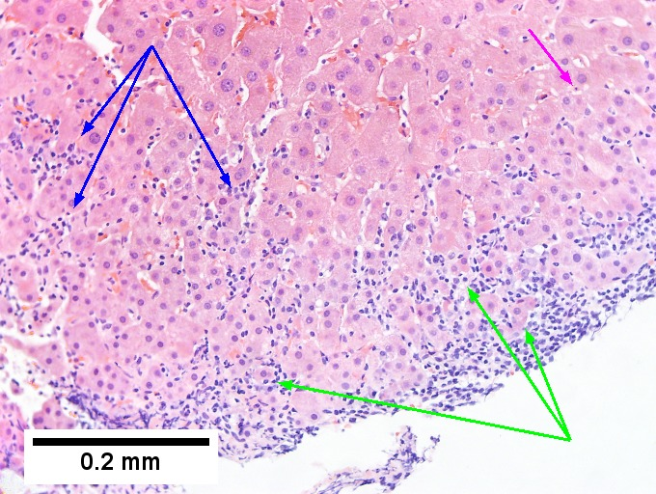
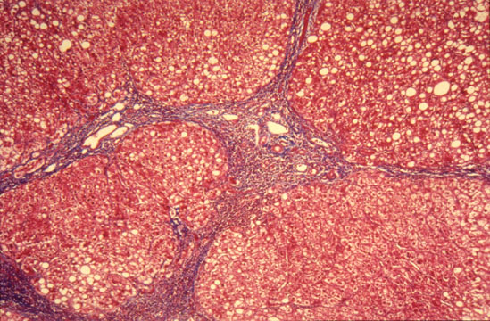
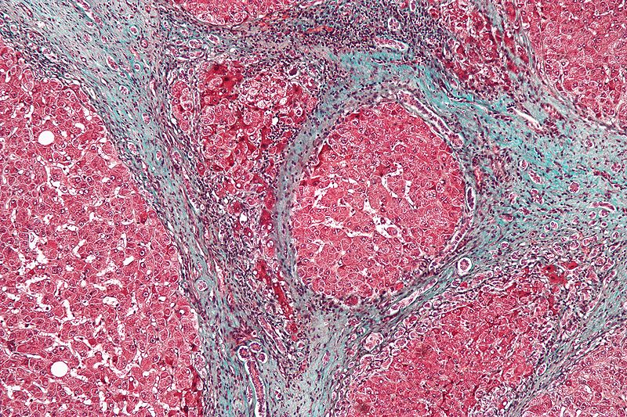
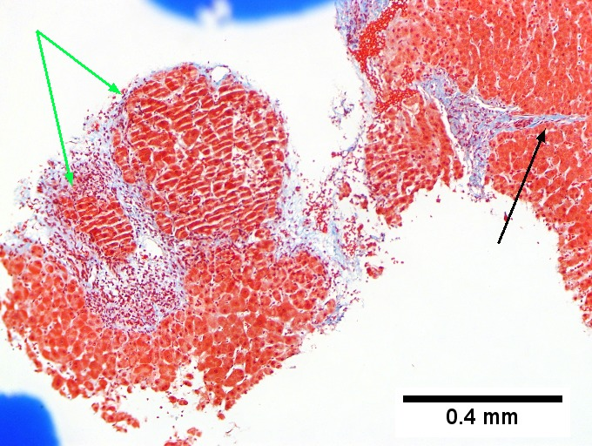
Hepatitis, Fibrosis, and Cirrhosis
Hepatitis virus infects hepatocytes
Immune response causes chronic inflammation
Tissue suffers long-term damage, including:
Fibrosis: abnormal deposition of matrix
Cirrhosis: fibrous scarring of the liver, with reduced liver function
Source: librepathology.org

Slide 22
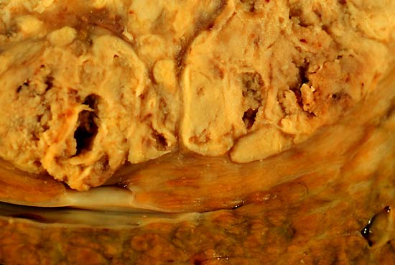
Primary cancer in the liver
Chronic inflammation and cirrhosis (scarring) can lead to mutational changes in hepatocytes
Mutated hepatocytes overproliferate to form hepatocellular carcinoma (HCC)
Some well-differentiated tumors try to recapitulate liver microanatomy
Less differentiated tumors lose the structure, are poorly vascularized, and develop large necrotic regions.
Source: librepathology.org

Slide 23
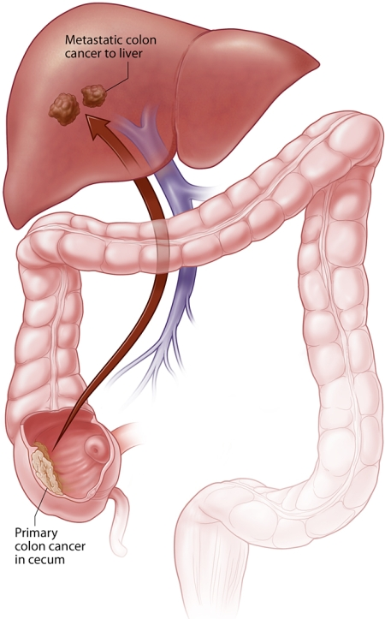
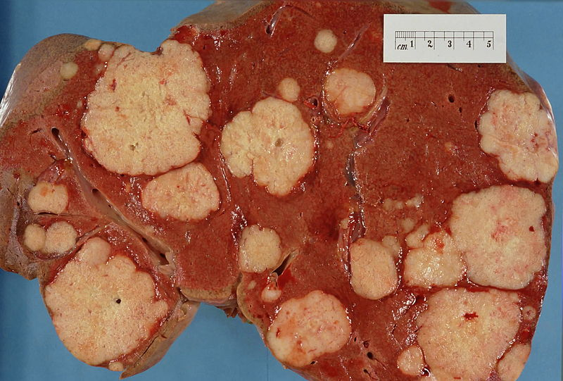
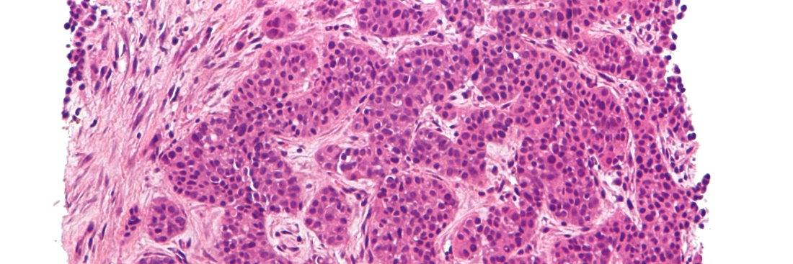
Metastases in the liver
The liver is “downstream” of many major organs, particularly the colon and pancreas.
Several major cancers metastasize to the liver:
Circulating cancer cell(s) extravasate and lodge in the liver
Small focal growths
Disruption of surrounding tissues
Major types:
Colon
Breast
Pancreatic adenocarcinoma
Gastric adenocarcinoma
Source: librepathology.org
Hopkinsmedicine.org

Slide 24
Schedule
3:00-3:20 | Macklin | Primer: Liver microanatomy and biology for modelers
3:20-3:40 | Glazier | Sensitivity analysis of toxicity of acetaminophen in a multiscale liver sinusoid simulation
3:40-4:00 | Sparks | Biomechanical modeling of tissue perfusion in decellularized and native liver
4:00-4:20 | Macklin | Agent-based simulation of colon cancer metastases in large liver tissues
4:20-4:40 | Frieboes | Modeling and calibration of cancer drug response
4:40-5:00 | Mumenthaler | High-throughput image-based experiments to drive cancer model development
5:00-5:30 | All | Discussion

